Slide 1

SECP3133
HIGH PERFORMANCE DATA PROCESSING
Project 2: Real-Time Sentiment Analysis using Apache Spark and Kafka
DATA DRILLERS
MUHAMMAD ANAS BIN MOHD PIKRI (A21SC0464)
MULYANI BINTI SARIPUDDIN (A22EC0223)
ALIATUL IZZAH BINTI JASMAN (A22EC0136)
THEVAN RAJU A/L JEGANATH (A22EC0286)
6 JULY 2026

Slide 2
Introduction
Project Goal:
Develop and implement a real-time sentiment analysis system.
Leverage Apache Spark for big data processing and Apache Kafka for seamless data streaming.
Key Pipeline Steps:
Data Ingestion: Stream raw review data into Kafka.
Data Processing & NLP: Utilize advanced NLP (cleaning, tokenization, feature generation).
Sentiment Classification: Deploy Machine Learning/Deep Learning models for positive, negative, neutral sentiment classification.
Real-Time Visualization: Present progressive insights on an interactive, user-friendly dashboard built with Streamlit.
Focus Area:
Analyze user sentiments from Google Play Store reviews for popular Malaysian e-wallet/e-commerce apps: Touch 'n Go, Boost, Grab, Setel, and Shopee.
Gain insights into user perceptions of these essential services in Malaysia.

Slide 3
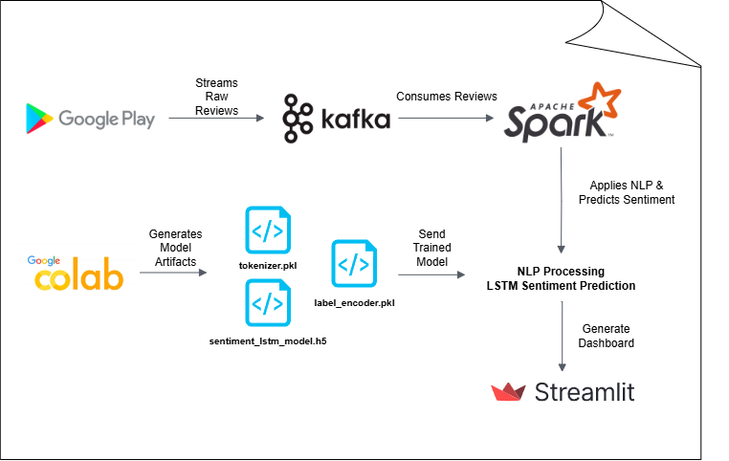
Workflow Overview

Slide 4
Data Acquisition
and
Processing
6 JULY 2026

Slide 5





Target Application
TOUCH’N GO
BOOST
GRABPAY
SETEL
SHOPEEPAY
my.com.tngdigital.ewallet
Widely used Malaysian e-wallet for toll payments, parking, shopping, and bills.
my.com.myboost
Malaysian digital wallet offering cashback, bill payments, and QR code payments
com.grabtaxi.passenger
Part of the Grab super app; used for rides, food delivery, and cashless transaction
com.setel.mobile
Fuel payment app by Petronas, allowing users to pay for petrol without leaving the car.
com.shopee.pay
Shopee's integrated wallet for seamless online purchases and QR payments.
5 / 16

Slide 6
Data Preprocessing
SCRAPING
Field | Description
app | App name
username | Reviewer name
review | Raw text of review
rating | 1 to 5 stars
date | Date of review
Scraping Details:
Tool Used: google-play-scraper (Python)
Runtime: Google Colab
Batch Size: 200 reviews per request
Sort Order: Newest first
WWW.REALLYGREATSITE.COM
3 / 16

Slide 7
Data Cleaning
Normalize text
🔤 LOWERCASING
Standardize and convert
🕓 DATE PARSING
🙂 EMOJI REMOVAL
via emoji.replace_emoji()
🕳️ EMPTY REVIEW FILTERING
Remove blanks or nulls
Keep only alphabetic
❌ DIGIT REMOVAL
Clean spacing & newlines
Using NLTK
🔄 WHITESPACE
NORMALIZATION
📚 STOPWORD FILTERING
WWW.REALLYGREATSITE.COM
5 / 16
19 AUGUST, 2021

Slide 8

Sentiment Model Development

Slide 9
Model Choice
Model | Why We Chose It
Naive Bayes (TF-IDF) | Fast, memory efficient, Spark-compatible for real-time use
LSTM Neural Network | Captures context, better with Malay slang and word order
🎯 OBJECTIVE:
TRADE-OFF:
Classify real-time user sentiment (Positive, Neutral, Negative) from Google Play Store reviews in Bahasa Melayu.
Naive Bayes → Used for fast, full-stream classification
LSTM → Used in Spark Kafka consumer for deeper insights

Slide 10
Training Process
DATASET USED FOR TRAINING
🧹 PREPROCESSING:
Source: Google Play Store reviews
Apps: Touch 'n Go, Boost, Grab, Setel, Shopee
Language: Bahasa Melayu
Labeling Rule:
⭐ 4–5 → Positive
⭐ 3 → Neutral
⭐ 1–2 → Negative
Total Records: ~100,730 reviews
Lowercase, emoji/punctuation removal (done before CSV)
Stopword removal (NLTK)
Whitespace normalization
Tokenization (Keras Tokenizer)
Padding (100 tokens)

Slide 11
Training Process
Model | Text Vectorization | Input Format | Train/Test Split
Naive Bayes | TF-IDF (5,000 words) | TF-IDF sparse matrix | 80/20
LSTM | Keras Tokenizer (10,000 vocab) | Padded sequences (100 tokens) | 80/20

Slide 12
Evaluation & Latency
📊 EVALUATION RESULTS:
Metric | Naive Bayes | LSTM (Keras)
Accuracy | 87.73% | 88.00%
Macro F1 | 0.55 | 0.56
Neutral F1 | 0.00 | 0.04
Positive F1 | 0.93 | 0.94
Negative F1 | 0.71 | 0.71
⚠️ LIMITATION:
Neutral class is underrepresented, affecting both models’ performance.
Future improvement: Use manual labeling or balance data.

Slide 13
Evaluation & Latency
⚡ PERFORMANCE (100,730 REVIEWS):
Metric | Naive Bayes | LSTM (Keras)
Total Time | 9 seconds | 11 minutes
Avg Latency | 0.09 ms | 6.55 ms
Deployment Method | Broadcast/REST | UDF (in Spark)
SUMMARY
Naive Bayes is extremely fast and easy to scale
LSTM shows better accuracy and handles Malay structure better
Final Decision: LSTM was selected and deployed in Spark Kafka pipeline for real-time sentiment analysis.

Slide 14
Apache System Architecture

Slide 15
Apache Kafka:
Real-time Data Ingestion
Advantages | Explanation
Decoupling | Producers & consumers operate independently.
Backpressure Handling | Captures context, better with Malay slang and word order
Data Durability | Messages persisted on disk, preventing loss.
Scalability | Supports many consumers without interference.
🎯 OBJECTIVE:
KEY COMPONENT
High-throughput, fault-tolerant streaming platform; central nervous system for data flow.
Producers: Google Play Store scraper fetches reviews and publishes them as messages to Kafka topics.

Slide 16
Apache Spark Streaming:
Real-time Data Processing
Advantages | Explanation
Scalable | Handles large data volumes across clusters.
Fault Tolerance | Minimizes data loss during failures.
Real-time Processing | Processes live streams quickly.
Unified Engine | Supports batch, streaming, ML, and graph workloads.
🎯 OBJECTIVE:
KEY COMPONENTS
Scalable, high-throughput, fault-tolerant processing of live data streams.
Consumers: Spark Streaming application subscribes to raw_reviews_topic and pulls messages.
Processing Model: Processes data in micro-batches (or continuously for lower latency).

Slide 17
Analysis and Results

Slide 18
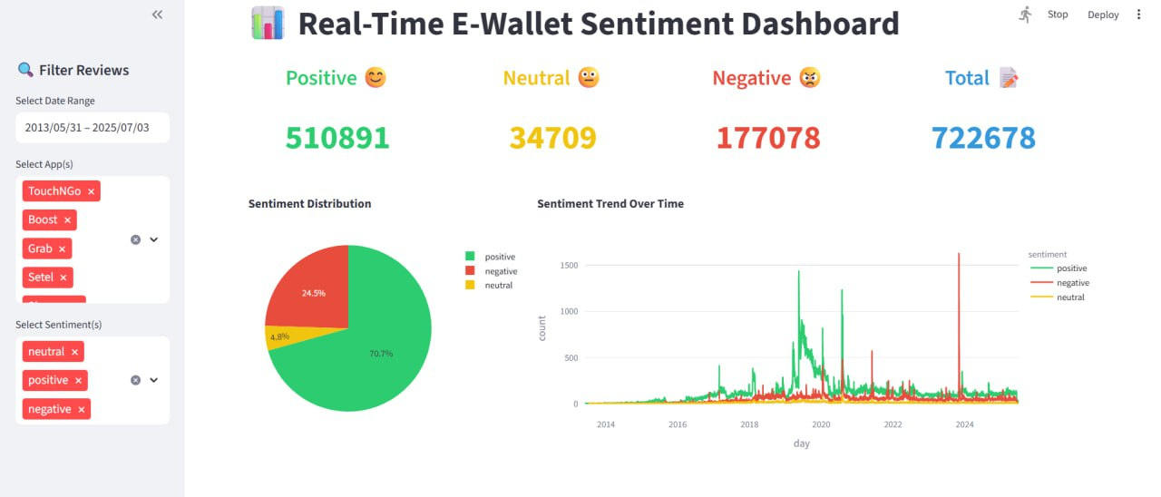
Dashboard Development
Tools for Dashboard | Key Features
Interactive Streamlit Dashboard | Real time data processing and interactive filtering for deep dives.
🎯 OBJECTIVE:
Transform raw e-wallet reviews into actionable insights.
DYNAMIC TRENDS
Sentiment changes over time, influenced by app updates or events.

Slide 19
Key Findings
📊 OUTCOME FROM ANALYSIS
Finding Types | Explanation
Overall Sentiment | Predominantly Positive High user satisfaction with e-wallet services
Mixed Feedback Present | Significant Neutral and Negative reviews Indicates areas for specific improvement
Dynamic Sentiment Trends | Fluctuations over time Correlates with events like app updates or campaigns.
Specific Issues | Negative reviews often cite common pain points such as app crashes, slow transactions and customer service issues

Slide 20
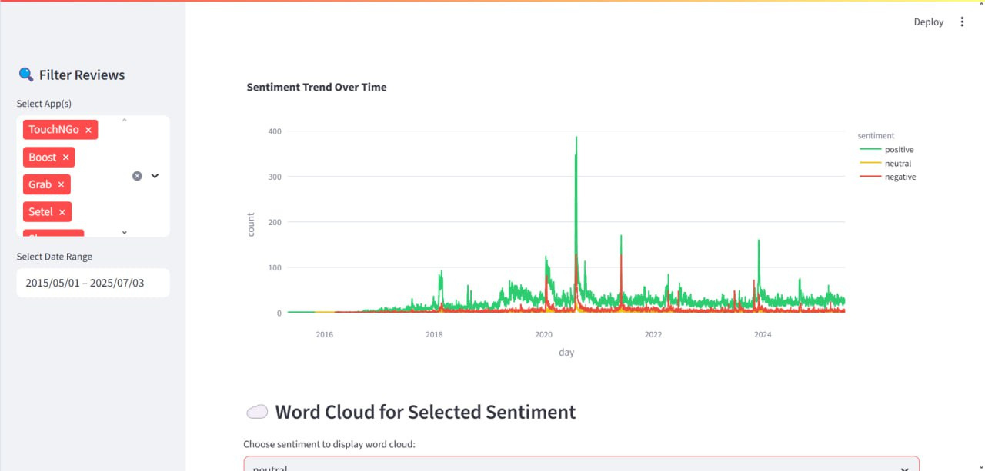
Outcome for Sentiment graph

Slide 21
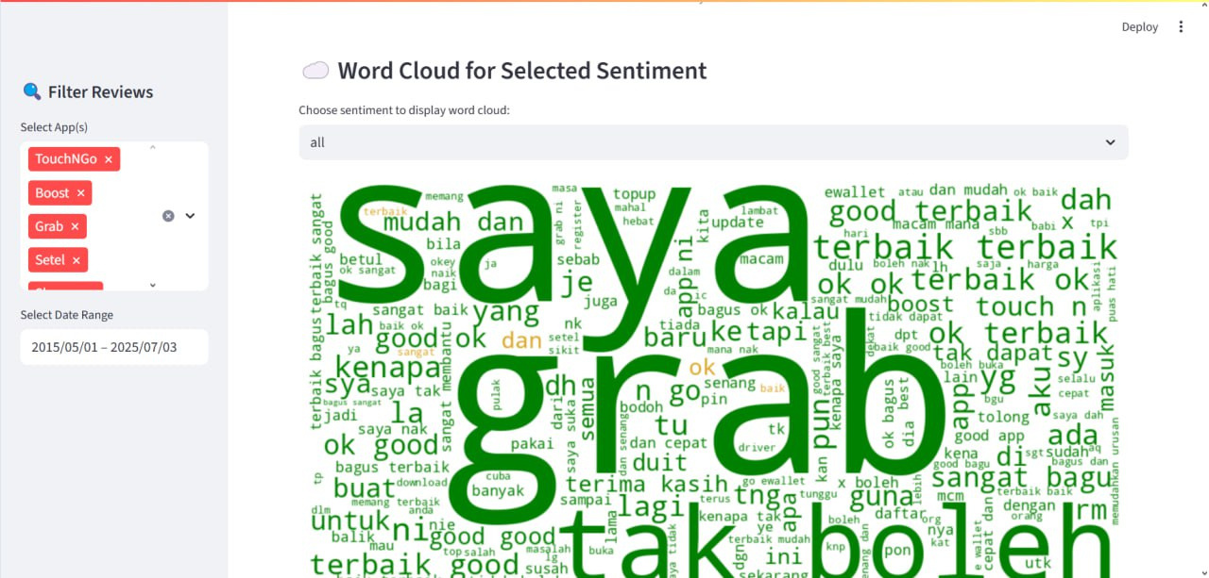
Outcome for All Sentiment Word Cloud

Slide 22
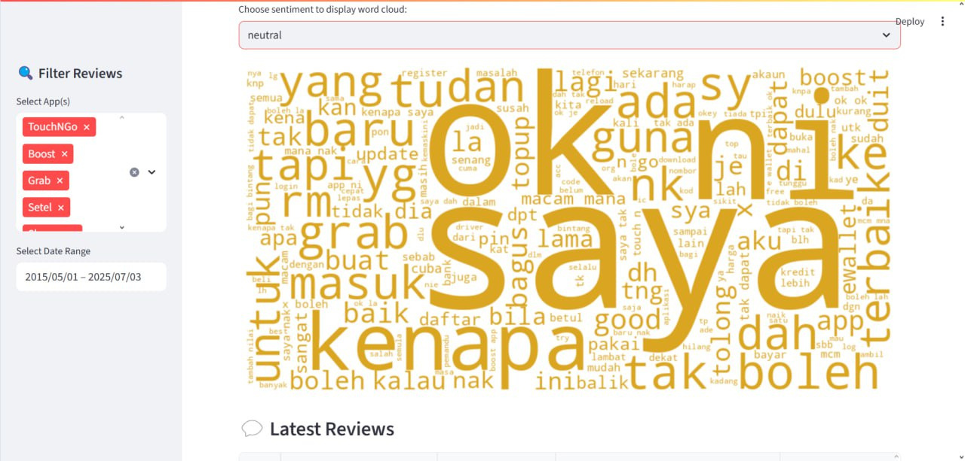
Outcome for Neutral Sentiment Word Cloud

Slide 23
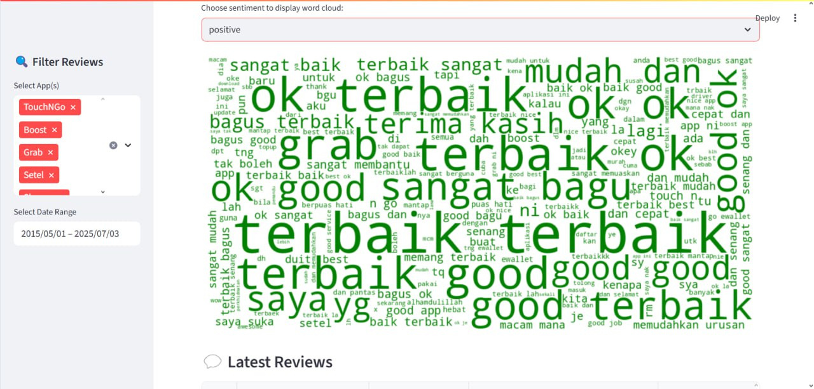
Outcome for Positive Sentiment Word Cloud

Slide 24
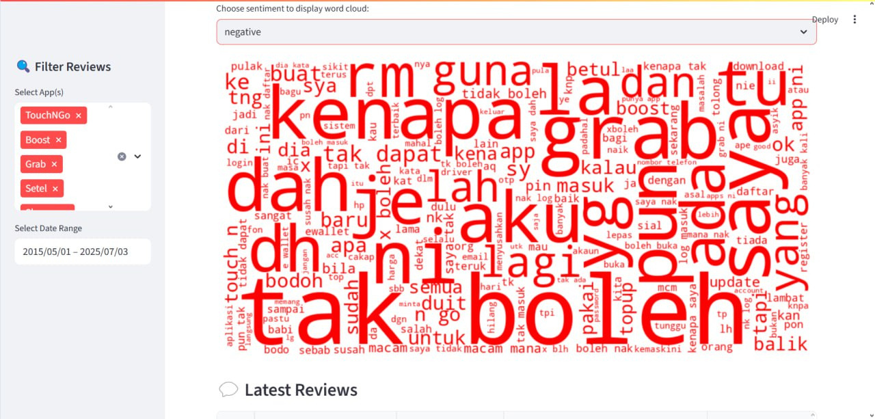
Outcome for Negative Sentiment Word Cloud

Slide 25
Model Comparison and Optimization

Slide 26
Model Comparison
Model | Naive Bayes | LSTM
Usage | Not explicitly shown for real time streaming Typically for batch processing or comparison | Real time data processing and interactive filtering for deep dives
Strength | Simplicity and Speed: Faster to train and make predictions | Contextual Understanding: Excels at capturing word order and contextual nuances in text
Weakness | Assumption of Independence: May not capture complex relationships between words | Computational Cost: More resource intensive to train and potentially to deploy for real time inference

Slide 27
Model Optimization
Model | Naive Bayes | LSTM
Primary Focus | Speed, Resource Efficiency, and a reliable Baseline performance | Accuracy Maximization, then Inference Speed and Contextual Understanding
Advantage | Faster training and prediction times, less computational overhead | Higher potential for sentiment accuracy, better understanding of nuanced text
Challenge | Lower accuracy ceiling for complex language patterns which is limited context | Higher computational cost (training & inference) which requires more data
Optimization Strategy | Feature engineering (n-grams), simpler model tuning | Hyperparameter tuning, advanced embeddings (BERT), model quantization or pruning

Slide 28
Thank You

